Slide 1
Sensor Sub-Module
Members:
Goh Guan Lin (2102916)
Bay Yi Kiat (2102016)

Slide 2
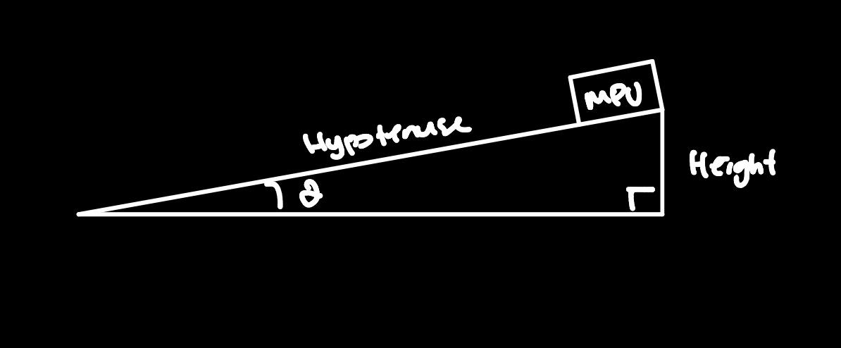
Accelerometer
Hardware: MPU6050 Platform: Raspberry Pi Pico
Algorithm to calculate height:
Use accelerometer data to calculate the tilt angle θ.
We have the hypotenuse as the
Solve the height using trigonometry.
Notes:
Software design to detect hump height using accelerometer.
Video explain algorithms on each sensor, how analyzing its accuracy and other differences.

Slide 3
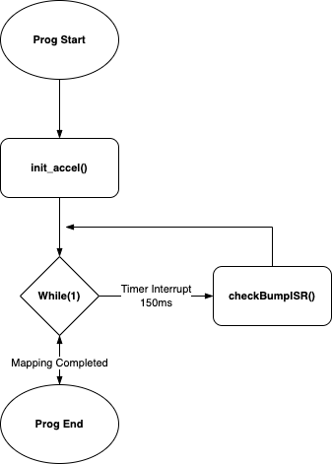
Accelerometer (Flowchart)

Slide 4
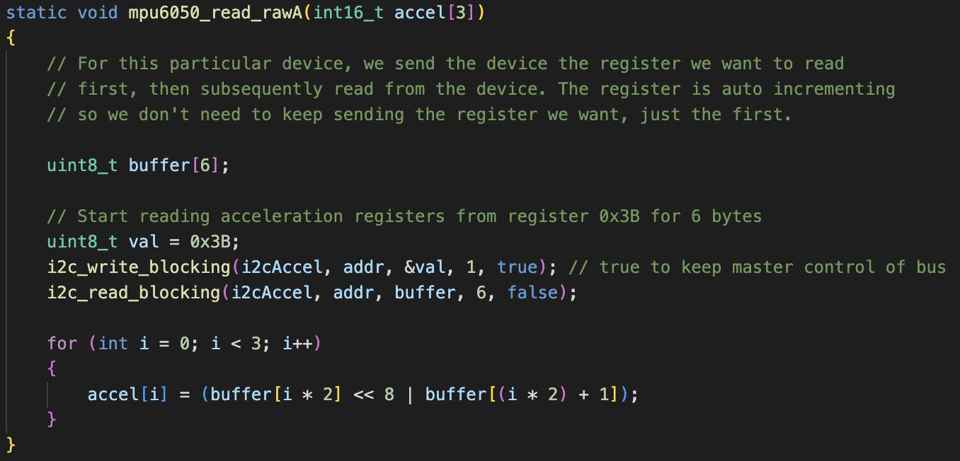
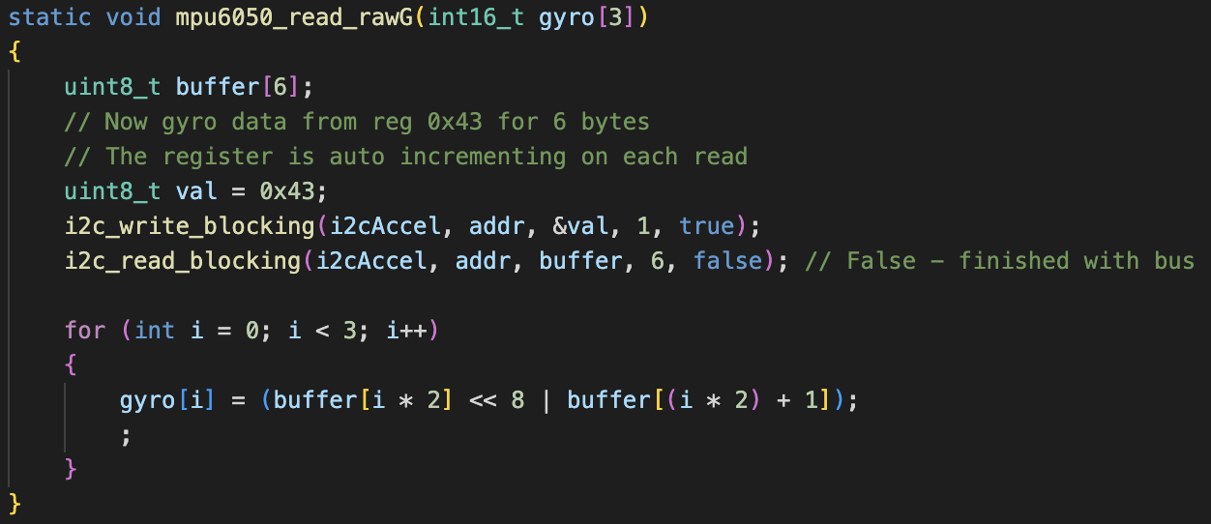
Accelerometer (Algorithm)
I2C to MPU6050 to read raw values.

Slide 5
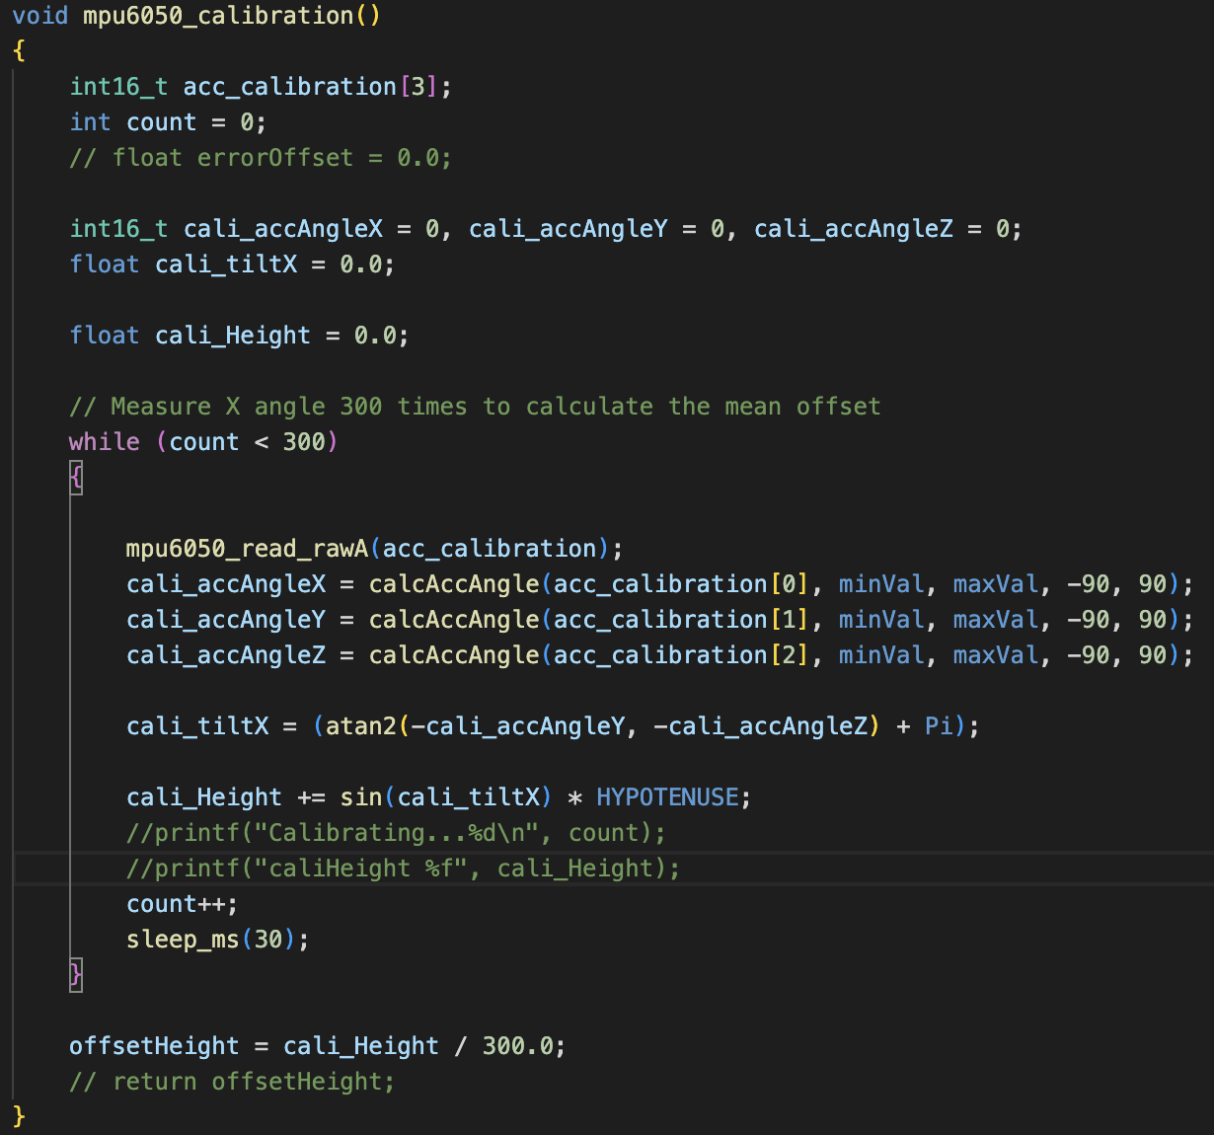
Accelerometer (Algorithm)
Calibration function to check calculate height offset
Run once before the entire program
Calculates the sum of height at current position of the MPU6050 for 300 times
Get the mean offset by Sum/300
To ensure that whichever position the MPU6050 starts at, is calibrated to 0cm to account for error.

Slide 6
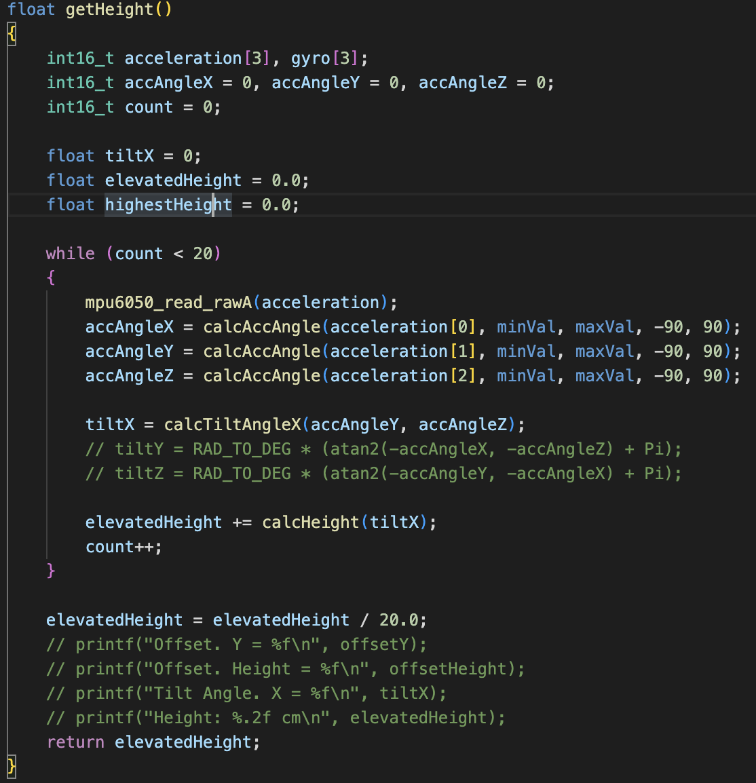
Accelerometer (Algorithm)
getHeight() function to calculate height of accelerometer in current position.
Read raw values for 20 times
Sum up the calculate height.
Get the mean height for a more accurate value

Slide 7
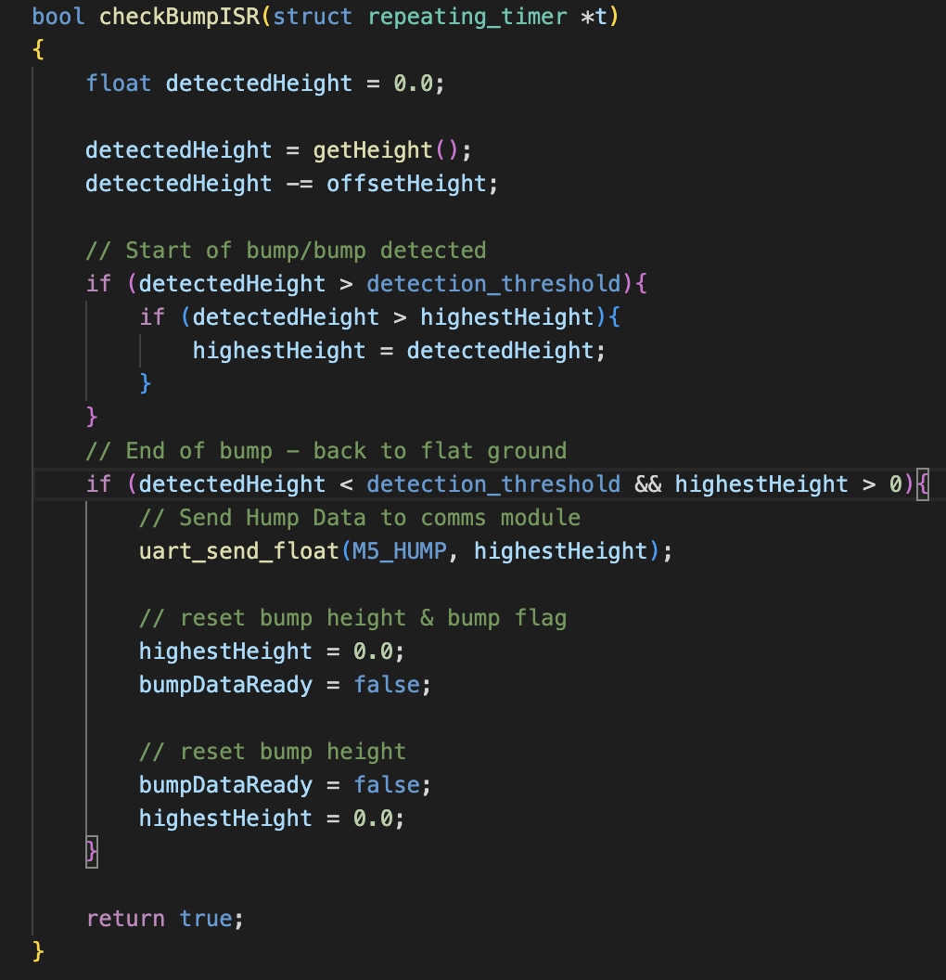
Accelerometer (Interrupt)
Timer ISR for reading & calculating height values
Interrupts the main program every 150ms
Gets the current position height
Check if height is above detection threshold which is set at 0.7cm (Start of bump)
Once height goes back below threshold, send data to comms (End of bump)

Slide 8
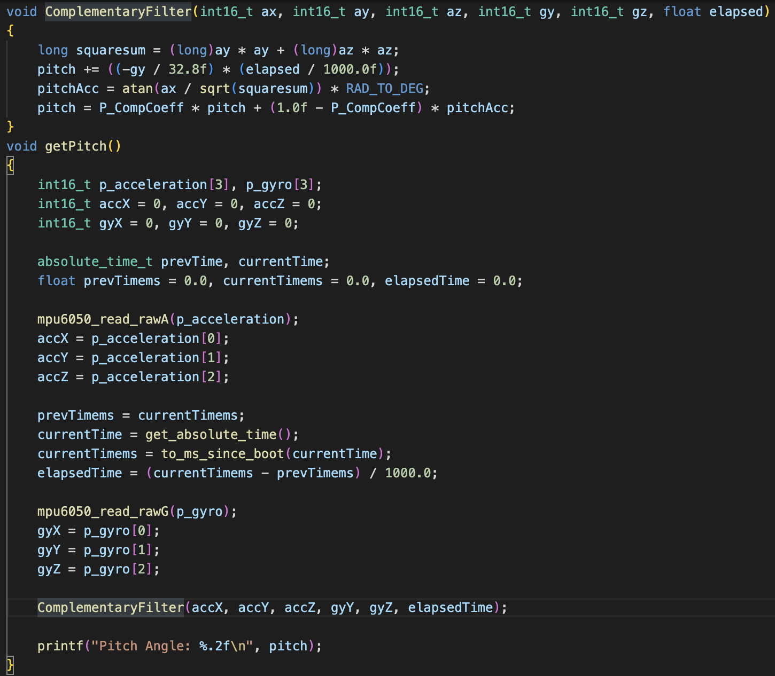
Accelerometer (Filter)
Complementary filter using both accelerometer axis and gyro axis to get Pitch angle
Accelerometer angle compensates for gyroscope drift
Gyroscope angle compensates for noise and error when the sensor is moved

Slide 9
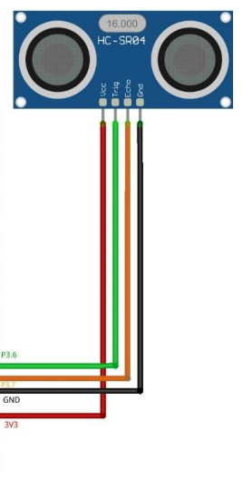
Ultrasonic
Ultrasonic Sensor HC-04
detect distance in front of the sensor
used to navigate its surroundings
Notes:
When will the ultrasonic sensor be called/activate Use interrupt to activate? In what form to output: Interrupt/polling?
Sample multiple times for data What kind of data to output?

Slide 10
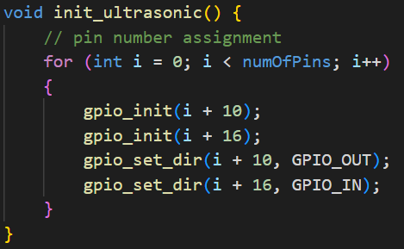
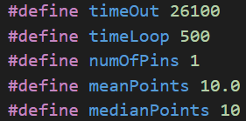
Ultrasonic (Algorithm)

Slide 11
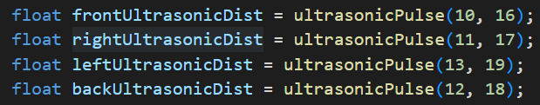
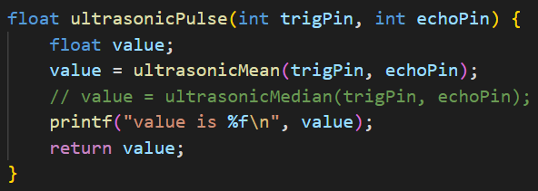
Ultrasonic (Algorithm)
function is called by the mapping module
filters raw data by either using the mean or median
Notes:
Plot charts to illustrate the different performances (e.g. the one shown in Lecture)
How analyzing its accuracy and other differences.

Slide 12
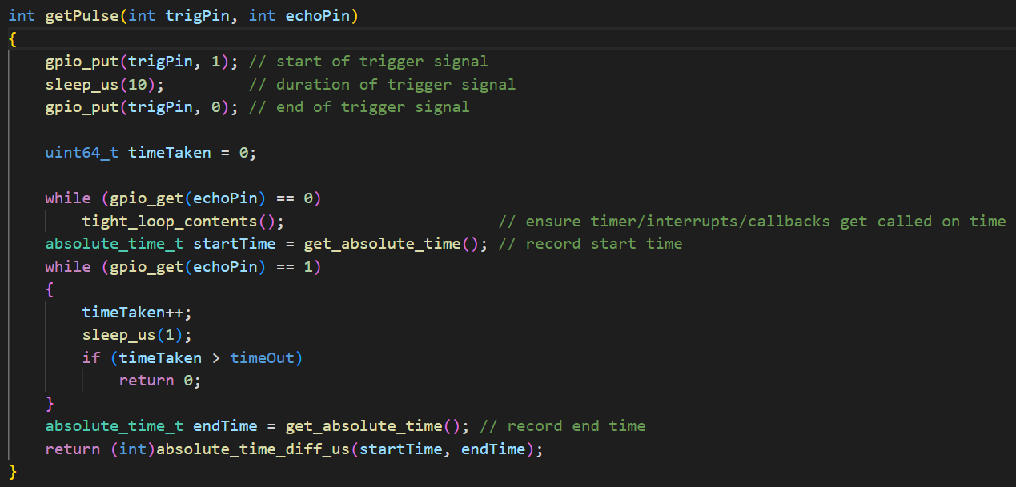
Ultrasonic (Algorithm)

Slide 13
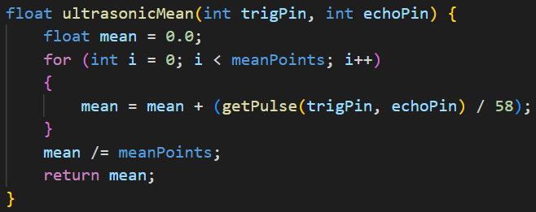
Ultrasonic (Algorithm)

Slide 14
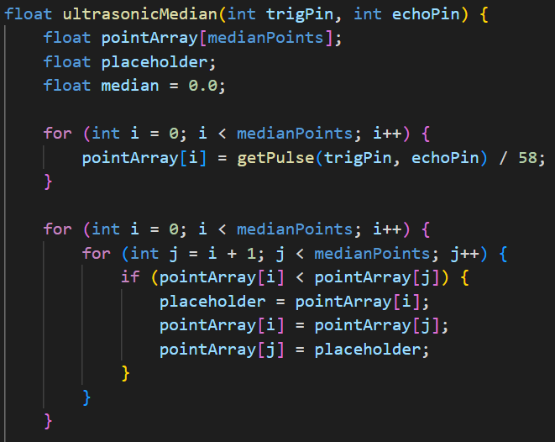
Ultrasonic (Algorithm)
Notes:
Plot charts to illustrate the different performances (e.g. the one shown in Lecture)
How analyzing its accuracy and other differences.
Show sufficient testing is done on this sub-module (black box/white box, etc)

Slide 15
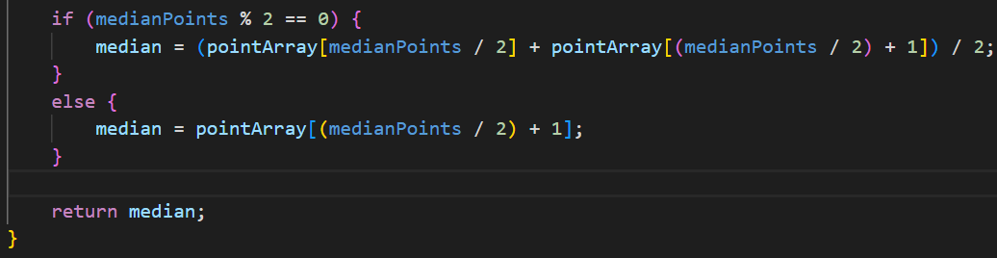
Ultrasonic (Algorithm)
Notes:
Plot charts to illustrate the different performances (e.g. the one shown in Lecture)
How analyzing its accuracy and other differences.

Slide 16
Ultrasonic (Performance)
Without any filters, reading one value is faster than reading ten
Using the mean to filter
harder to respond to sudden changes,
more accurate with gradual changes
Using the median to filter
not affected by outliers
ignore sudden changes

